Slide 1
Water Loss Audits Using the AWWA M36 Software – Creating and Implementing an Audit for Your System
Peter Nathanson
peternathanson2018@gmail.com
Notes:
1

Slide 2
What we will learn
2
What is a Water Audit?
What are the Benefits to annual water audits?
What triggers voluntary & required water audits?
How to conduct a water audit using AWWA M36 software
How to interpret and report data validity
How to interpret audit results – Volumes and Values
How to interpret results from AWWA M36 software
How to use results to implement corrective actions

Slide 3
Acknowledgements
3
Majority of original content developed by Cavanaugh & Associates and SWEFC under contract to NMED-DWB
Further content added by DWB Technical Services staff:
  Michael Peterson
  Peter Nathanson
  Brian Barrick
  Martin Torres

Slide 4
Old Terminology – no longer used
4
Unaccounted For Water
  Fails to segregate water loss into its components for effective management
  Unreliable indicator of performance
Unaccounted for Water Percentage
  <10 % acceptable
  10-15% needs attention
  > 15% needs immediate attention

Slide 5
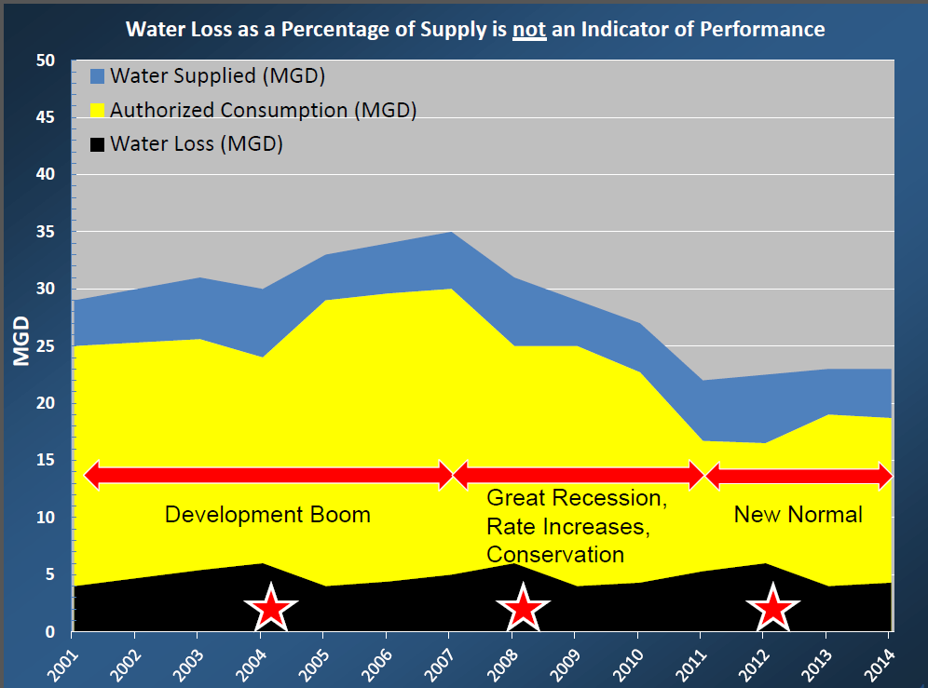
Unaccounted for Water Percentage
5

Slide 6
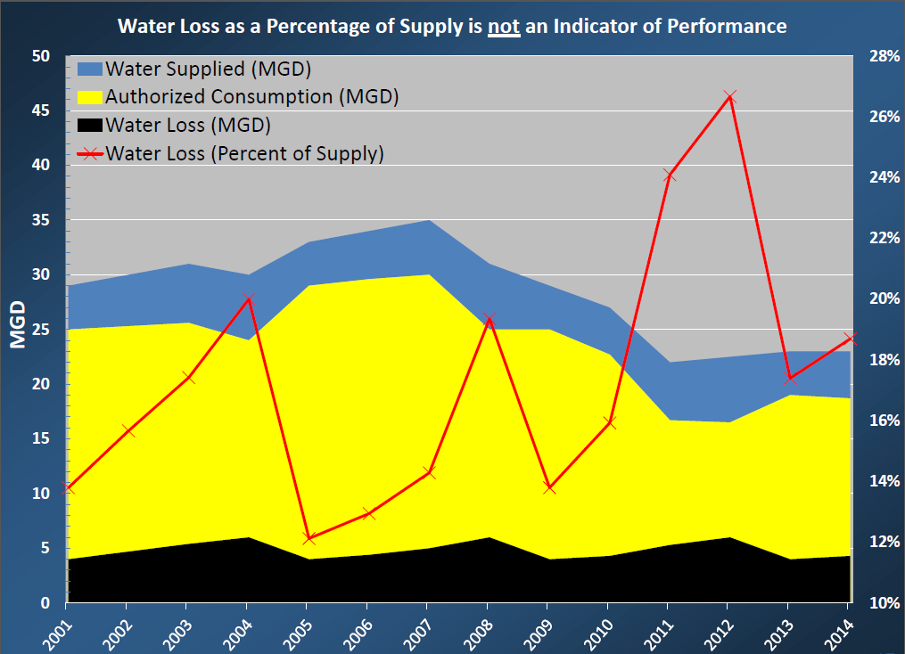
Unaccounted for Water Percentage
6

Slide 7
What is the Water Balance?
7
In this section you will learn to:
1) Utilize the Water Balance
2) Separate Total Water Loss into Real and Apparent Loss
3) Separate Real and Apparent Loss into their sub-components
4) Use metrics in units of Volume, Value, & Validity

Slide 8
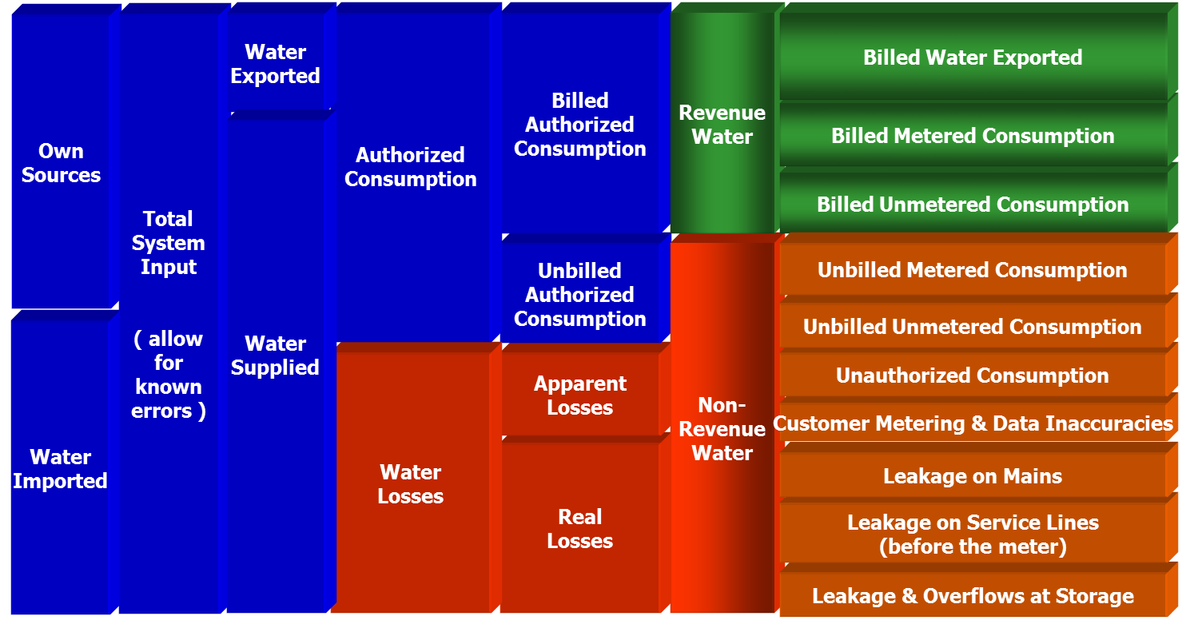
AWWA Water Balance
8

Slide 9
Billed Water Exported
9
Water exported to consecutive connection systems sold at a wholesale rate
Required data:
  Volume (annual & monthly)
  Revenue (annual & monthly)
Data issues:
  Metered or estimated water consumption?
  Metering inaccuracies
  Data transcription

Slide 10
Billed metered consumption
10
Water sold at retail rate to customers/members of the water system
Required Data:
  Rate Structure
  Volume sold (annual & monthly)
  Revenue (annual & monthly)
Data issues:
  Metered or estimated consumption?
  Meter inaccuracy
  Data transcription

Slide 11
Billed Unmetered Consumption
11
Flat-rate, non-metered customer (Construction contracts, Fire Department)
Required data:
  Estimated volume consumed (annual & monthly)
  Revenue (annual & monthly)
Data issues:
  No meters
  Estimated volumes

Slide 12
Unbilled Metered Consumption
12
Water that is delivered to customers who don’t pay, but volume consumed is recorded
Required Data
  Usage (annual & monthly)
  Fire Department usage, if Fire Department uses meters during training & suppression (annual & monthly)
Data issues
  Meter inaccuracy

Slide 13
AWWA Water Balance
13
Own
Sources
Total
System
Input
( allow
for
known
errors )
Water
Exported
Authorized
Consumption
Billed
Authorized
Consumption
Revenue
Water
Billed Water Exported
Water
Supplied
Billed Metered Consumption
Billed Unmetered Consumption
Unbilled
Authorized
Consumption
Non-
Revenue
Water
Unbilled Metered Consumption
Water
Imported
Unbilled Unmetered Consumption
Water
Losses
Apparent
Losses
Unauthorized Consumption
Customer Metering Inaccuracies
Systematic Data Handling Errors
Real
Losses
Leakage on Mains
Leakage on Service Lines
Leakage & Overflows at Storage

Slide 14
AWWA Water Balance
14
Unbilled
Authorized
Consumption
Non-
Revenue
Water
Apparent
Losses
Real
Losses

Slide 15
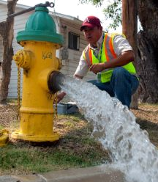
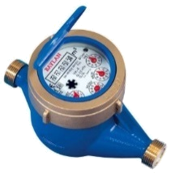
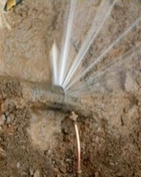
Non-Revenue Water
15
Unbilled Authorized:
  Fire Department
  Operational Flushing
Apparent Losses:
  Non-physical/revenue loss
  Meter inaccuracy, billing issues, theft
Real Losses:
  Physical losses
  Leaks, Storage overflow
Unbilled
Authorized
Consumption
Non-
Revenue
Water
Apparent
Losses
Real
Losses

Slide 16
Apparent Losses - Unbilled unmetered Consumption
16
Water delivered to customers that do not pay for water service; Fire suppression
Required Data:
  Estimates of volume used for fire services (annual & monthly)
  Estimates of volume supplied to customers (annual & monthly)
  Operational Flushing volumes if not metered (annual & monthly)
Data issues:
  Estimates, not known data

Slide 17
Apparent Losses - Unauthorized Consumption
17
Includes water that is taken against the policies of the water utility (Illegal connections, open bypasses, misuse of fire hydrants, theft)
Required data:
  Examine occurrences of unauthorized consumption, obtain quantities.
Data issues:
  Estimates
  Poor records for basis of estimating

Slide 18
Apparent Losses - Customer metering & data inaccuracies
18
Customer meter considerations
  Meter age?
  Testing/calibration policy?
  Replacement policy?
  Is the meter the right meter for the job?
Required Data
  Average customer meter inaccuracy (%), weighted by meter size if available (annual)\
Data issues
  Data trancription

Slide 19
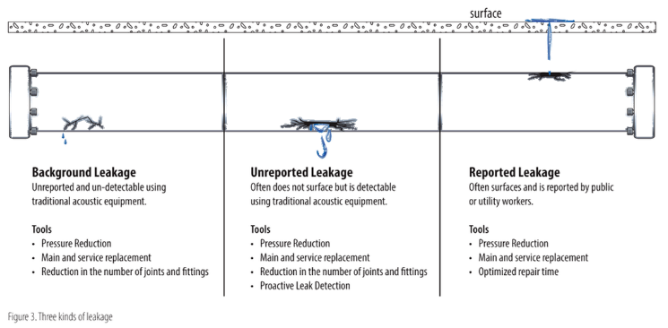
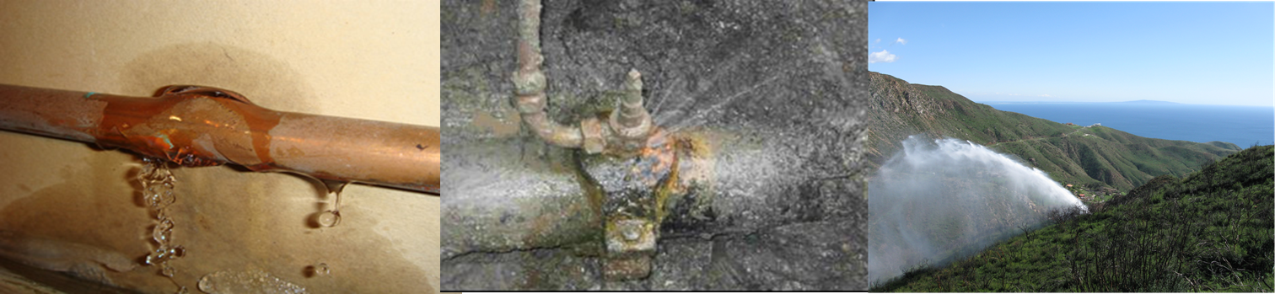
Real Losses - Leakage on Mains
19
Leakage at joints or along pipe sections of distribution main
Required data:
  Estimates of
leakage
Data Issues
  Estimates, data
transcription

Slide 20
Real Losses - Leakage along service lines
20
Leakage along service connection lines
Data requirements:
  Estimated average loss on service connection between distribution main and customer meter, multiplied by amount of connections
  Average length of service line
Data issues:
  Estimation
  Data not routinely collected

Slide 21
Real Losses - Leakage & overflow at storage
21
Leakage from storage facilities due to:
  Overflow (check SCADA/pressure switches to control pump)
  Inadequate facility walls
  Inadequate facility foundation
Data requirements:
  Estimated volume lost from storage leakage (annual)
Data issues:
  Estimates
  Data not routinely collected

Slide 22
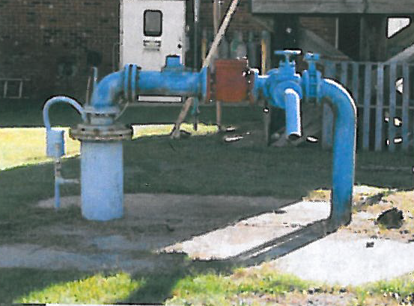
Meter Inaccuracy
22

Slide 23
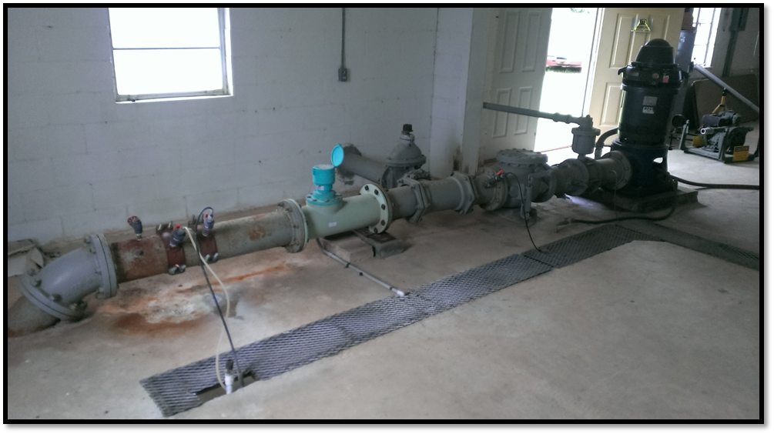
Meter Inaccuracy
23
8” Propeller Meter
Accuracy results from MFR test bench: 99.5%
Well Pump
Accuracy results from in-situ test: 142.2%
Check Valve
Courtesy MESCO

Slide 24
Benefits of completing annual audits
24
Increased knowledge of water system
Metric to determine areas to focus to improve overall system performance
Improved future asset and maintenance project planning
Streamline billing & operations

Slide 25
Why should our PWS do a Water Loss Audit? 1
25
Water Resources Management Concerns
  Only water needed for usage is withdrawn
  Limit need for additional water resources
  Ease water restrictions
  Serve additional customers without expanding source
Financial Concerns
  Recover revenue from customers that have been underpaying, or not paying
  Reduce operational costs for pumping, chemical treatment and maintenance
  Reduce liability

Slide 26
Why should our PWS do a Water Loss Audit? 2
26
Operational Concerns
  Increased knowledge of distribution system
  Basis for optimized operations
  Safeguard public health and safety
  Improved public relations
  Reduced disruption to customers
System Integrity
  Improved data integrity
  Review of customer billing practices and procedures
  Prevention of contamination

Slide 27
Voluntary Triggers
27
PWS suspects major water loss and:
  Wants to physically look for leaks (post-holing)
  Wants to request public funding for distribution system rehabilitation
DWB/SWEFC can provide assistance completing water audit

Slide 28
Required Triggers
28
DWB
  Enforcement, Case-by-case basis
NMOSE
  Water Conservation Planning Guide for Public Water Suppliers

Slide 29
How to Conduct Audit using AWWA M36 software
29

Slide 30
What information do we need to complete a water audit? (1 of 4)
30
Master/Source Meter volumes (annual & monthly)
  Include master meters for bulk purchase or wholesale
Customer meter data (annual & monthly)
  Volume of water sold @ retail rate
  Volume of water sold @ wholesale rate
List of unbilled customers (metered & non-metered), Number of active & inactive service connections

Slide 31
What information do we need to complete a water audit? (2 of 4)
31
Rate Structure
  Volume of water sold @ retail rate
  Volume of water sold @ wholesale rate
Total annual cost of operating water system (salaries, vehicles, maintenance, power, chemicals, etc.)
Total annual cost for power and chemicals for water production/purification/disinfection
Total length of distribution mains

Slide 32
What information do we need to complete a water audit? (3 of 4)
32
Occurrence of leaks (annual & monthly)
Source/Master Meter info:
  Age
  Date of last calibration
  Calibration records if available
Customer Meter info:
  Average age
  Testing/replacement policy

Slide 33
What information do we need to complete a water audit? (4 of 4)
33
Policies/Procedures for:
  Source meters
  Customer meters,
  Meter replacement policy
  Operational policies
  Financial & recordkeeping
Normal practices relating to flushing for operators, fire hydrant flushing, fire suppression logs.

Slide 34
AWWA Free Water Loss Audit Software
34
Standard Data Collection tool in North America
Inputs
  13 volume inputs
  5 system attribute inputs
  3 cost inputs
After Default or n/a’s
  10-12 inputs to actually deal with
https://www.awwa.org/home/awwa-news-details/articleid/2641/awwa-free-water-audit-software-version-5-0-now-available.aspx

Slide 35
Develop the inputs
35
Develop the input
  Trace from production reports
  Trace from meter testing reports
Data Validity
  Look for missing/extra volumes
  Mismatched timeframe
  Error adjustment should be weighted average

Slide 36
Develop the inputs
36
Data from:
  Billing reports
  Flushing tracker
  Fire department tracker
Data validity Issues
  Billing report inaccuracies
  Double counting Water Exported in Billed Metered
  Double counting Unbilled Metered consumption in Billed Metered Consumption
  Including leaks/breaks in Unbilled Unmetered

Slide 37
Develop the inputs
37
Data from:
  Billing/usage reports
  Customer Meter calibration records
  Approximate from meter system, age/condition
Data Validity Issues
  Customer meter calibration not always known, estimates

Slide 38
Develop the inputs
38
Data from:
  System maps
  Billing system/ database
Data Validity Issues
  Include hydrant leads in Length of Mains
  Include inactive connections
  Billing system reports customers, not connections

Slide 39
Develop the Inputs
39
Data from:
  Operating budget
  Rate structure
Typical Ranges:
  $2-$10/kgal for CRUC
  $200 - $1000/MG for VPC (systems producing water)
Data Validity Issues
  Don’t include wastewater costs if associated budget
  Consider sewer rates in customer retail unit cost
  Confusing units for variable production costs

Slide 40
How to conduct a Water Audit - Activity 1
40
Placeholder for Hands-On Activity #1
  download and run initial water audit using Rockville WSC data
  Follow-up using your own system data

Slide 41
Data Validity
41

Slide 42
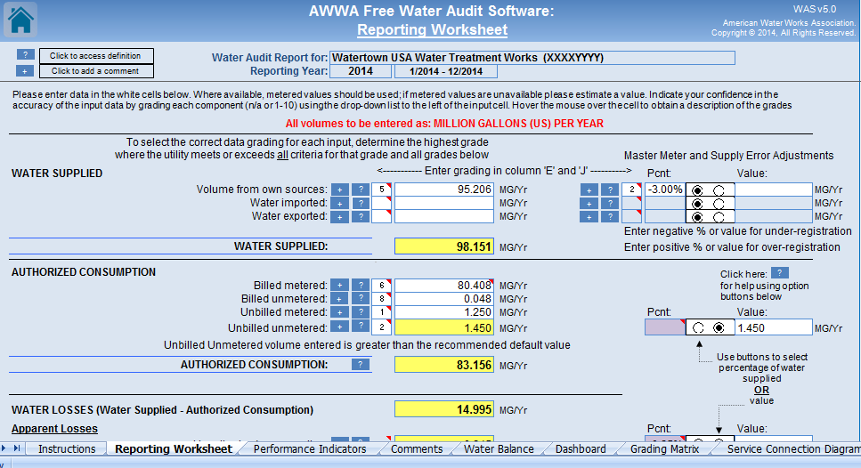
Data Grade Entry
42
Data Grades

Slide 43
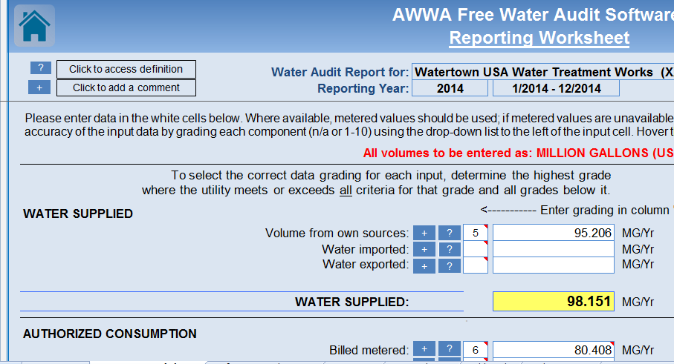
Data Grade Entry
43
Hover the cursor over the red triangle in the corner

Slide 44
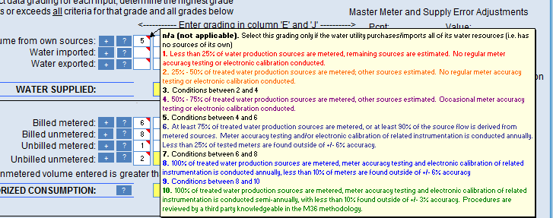
Data Grade Entry
44
Data Grade criteria will show up in a pop-up box

Slide 45
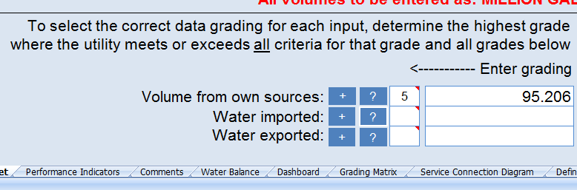
Data Grade Entry
45
Note the comment on the water audit spreadsheet.

Slide 46
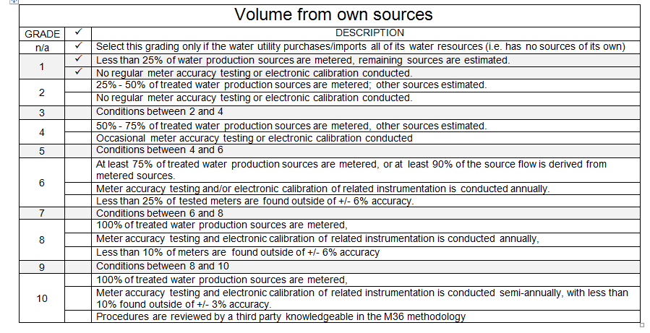
Data Grade Selection
46
If you are able to check all the boxes move up.

Slide 47

Data Grade Selection
47
If you are able to check all the boxes move up.
If you aren’t able to check all the boxes move down.

Slide 48

Data Grade Selection
48
If you are able to check all the boxes on one number and only some of the boxes on the number two above, choose the “conditions between…” box.

Slide 49
What is the Right Data Grade?
49
ANY NUMBER AS LONG AS IT ACURATELY REPRESENTS THE TRUE SITUATION

Slide 50
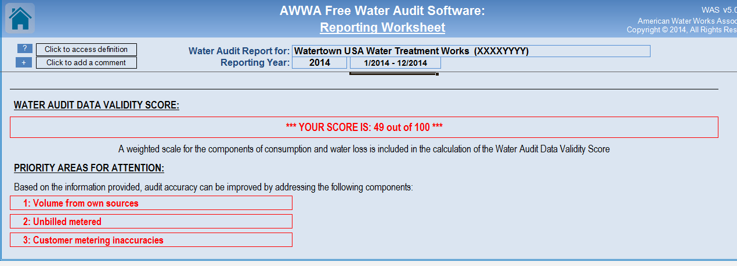
Data Grade Entry
50
Water Audit Data Validity Score

Slide 51
If the Data Validity Score is below 50, What Should be the Response?
51
What Response?

Slide 52
Data Grade Entry
52
Priority Areas for Attention to Increase Validity Score
Note: The data grades do not have equal value in the calculation of validity

Slide 53
If Data Validity Score is greater than 50, What should be the response?
53
Evaluate the Metrics
*** YOUR WATER AUDIT DATA VALIDITY SCORE IS: 58 out of 100 ***
>50 (validated
score)
4 - 40
20 – 200
400 – 4000
2 – 10

Slide 54
Check the Metrics
54
4 – 40
20 – 200
400 – 4000
2 – 10
Metrics vs. Practices
  Inside the range – are they high, mid, or low?
  How does that compare to water loss management practices?

Slide 55
If Data Validity Score is greater than 50, What should be the response?
55
Evaluate the Metrics
*** YOUR WATER AUDIT DATA VALIDITY SCORE IS: 71 out of 100 ***
>50 (validated
score)
4 - 40
20 – 200
400 – 4000
2 – 10

Slide 56
Data Validity – Activity 2
56
Placeholder for Hands-On Activity #2
  update initial audit from Rockville WSC data validity info
  Check for data validity issues
  Include data validity scoring
Applied Activity #2
  update your system audit with data validity grades
  Note from audit results top 3 priority areas for further investigation needed to improve overall data validity score

Slide 57
Corrective Actions – Data Validity Score < 50
57
Improve Data validity for next audit cycle
  Install customer meters, or implement calibration policy
  Install or calibrate source meters
  Improve policy on water usage estimates for non-metered users

Slide 58
Corrective Actions – Data Validity Score > 50
58
Flow Tests on Supply/master meters
Signal calibration
Scrub of production data:
  Data gaps
  Irregular patterns
Scrub billing Data:
  Duplicate volumes
  Non-potable volumes
  Wrong timeframes
  Irregular patterns

Slide 59
Audit Results - Volumes and Values
59
Software calculates loss of water in Volume and Cost (Non-revenue water)

Slide 60
Volumes and Values – 3-V concept
60
Volume
MG per Year
Gal/connection/day
Leakage Index
Value
Validity
$ per Year
Economic Loss Index
Water Audit Data Validity Score
95% Confidence Limits
Key Data Input Grades

Slide 61
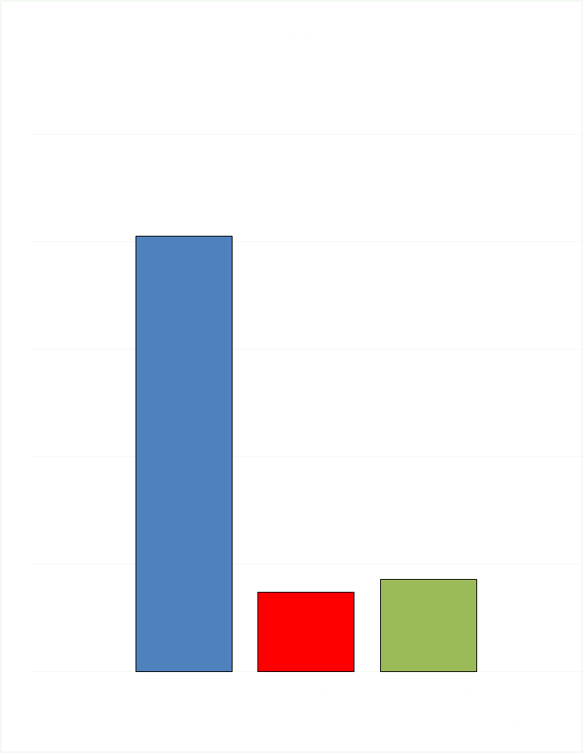
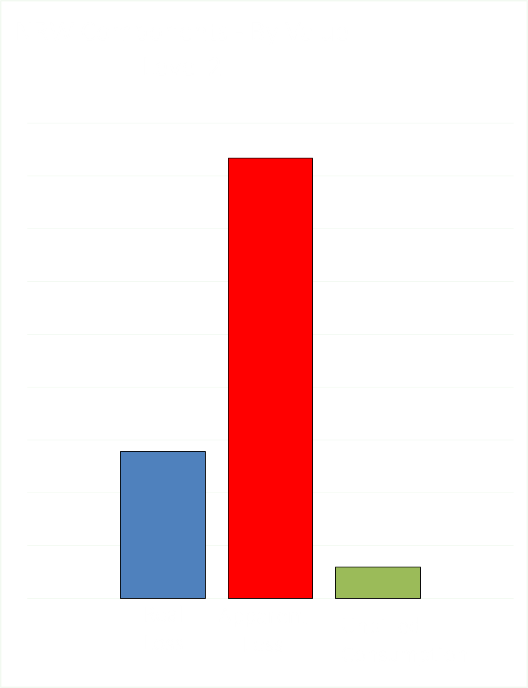
Volume
Value
61
Notes:
Then at the next level – the 3 main ‘components’ of NRW - - Real Loss, Apparent Loss and Unbilled Consumption
Volumes and Values of each - - this is how you are able to dial in further on where the opportunities lie

Slide 62
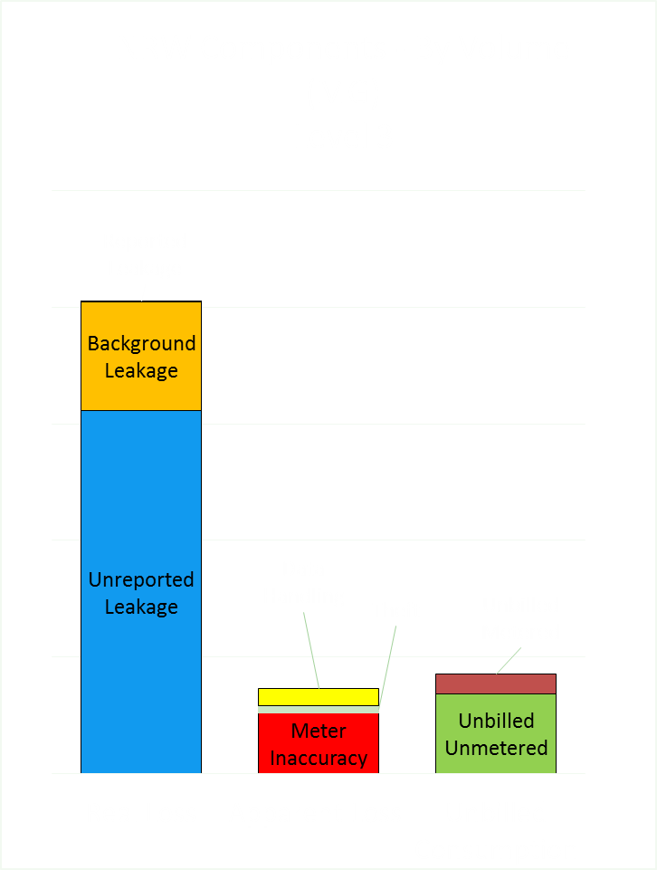
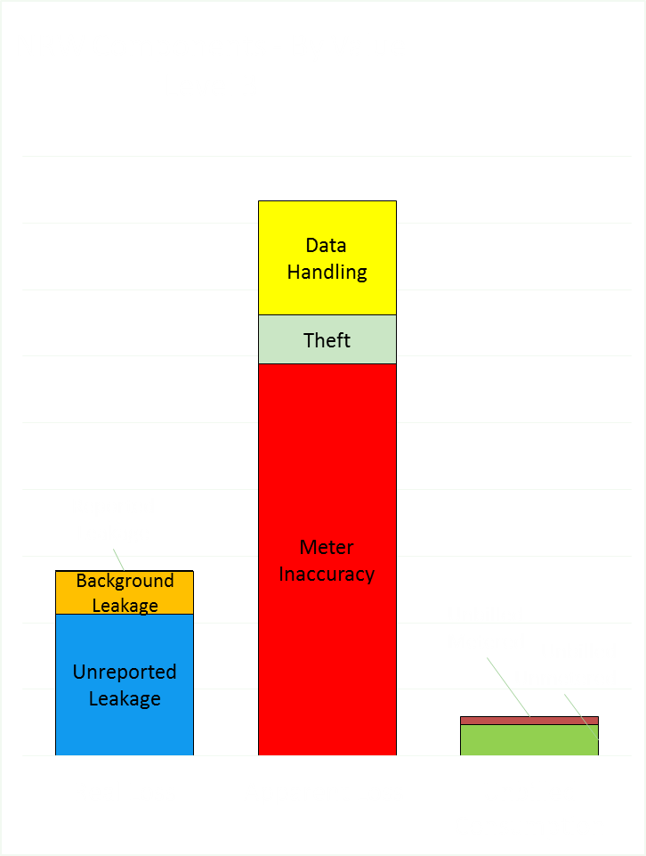
Volume
Value
62
Notes:
Then at the next level – subcomponents of each of the 3 NRW components. This is where rubber starts to meet the road.
This is where we begin to see where the real opportunities and priorities lie. In this example – it is Meter Inaccuracy and Unreported Leakage. {point out red and blue bars on $$ chart}

Slide 63
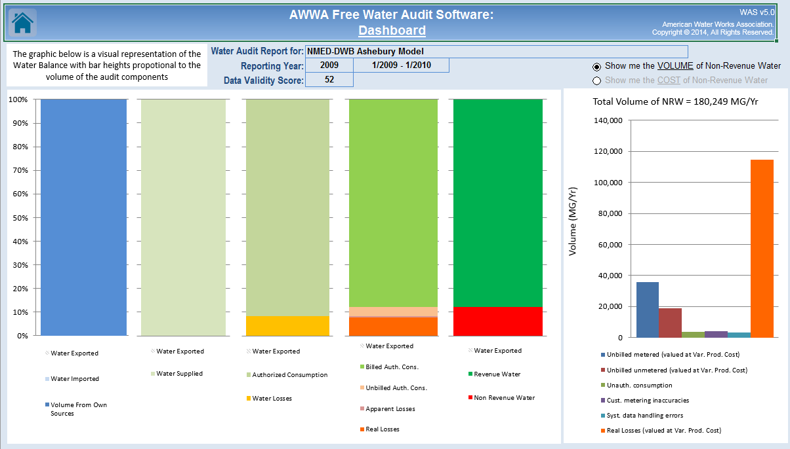
Volumes and Values – Large System Volume
63
1.5 MG/yr supplied, $3 million/yr total cost to operate water system

Slide 64
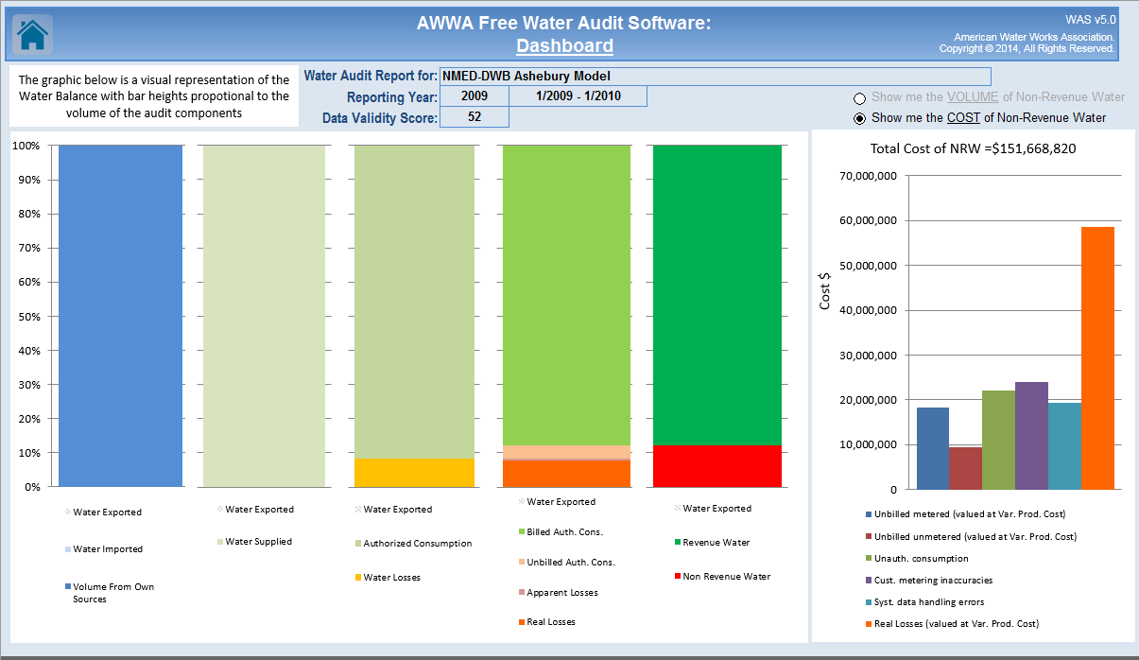
Volumes and Values – Large system Cost
64
System info: 1.5 MG/yr supplied, $3 million/yr total cost to operate water system

Slide 65
How to interpret results
65

Slide 66
Corrective Actions – Data validity Scores > 50
66
Improve system performance, identify if Real Loss or Apparent Losses dominate
  Status Component Analysis for Real Loss
  Status Component Analysis for Apparent Loss

Slide 67
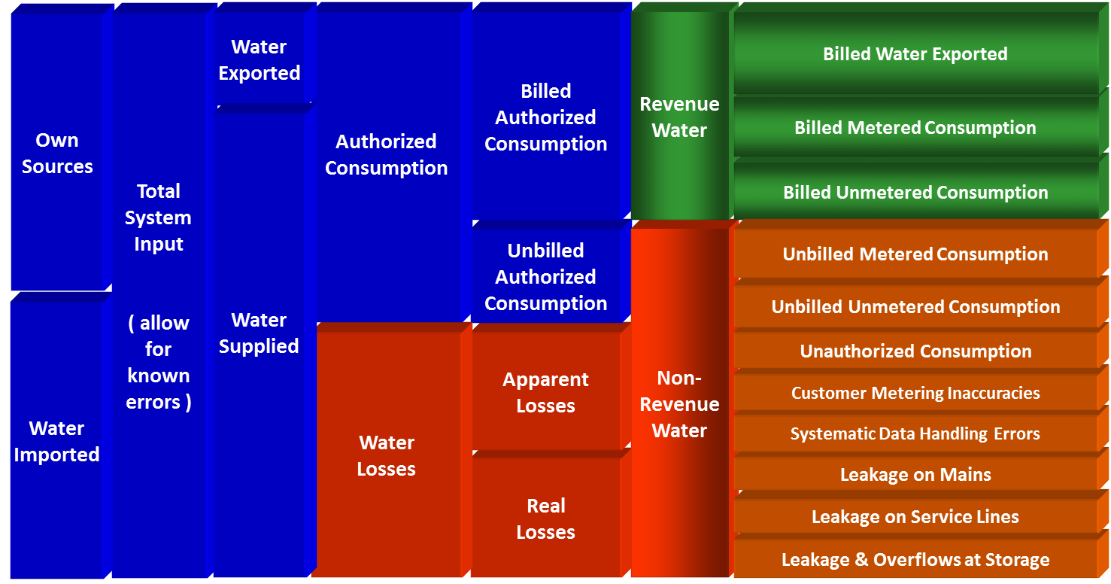




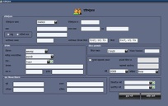

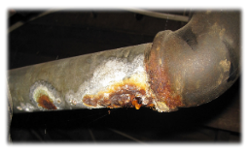
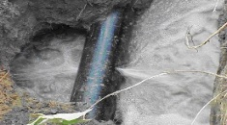
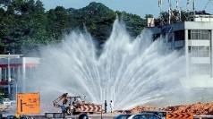
Real Loss Component analysis
Background
Unreported
Reported

Slide 68
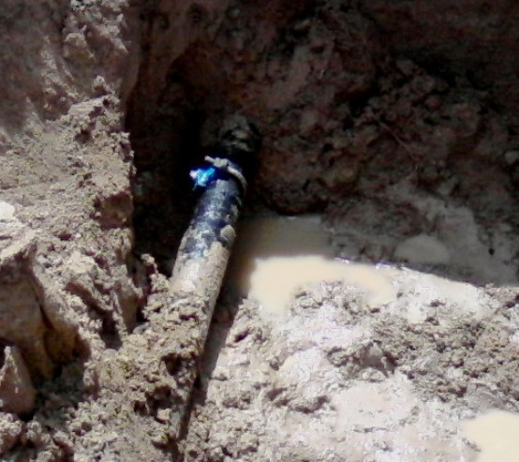
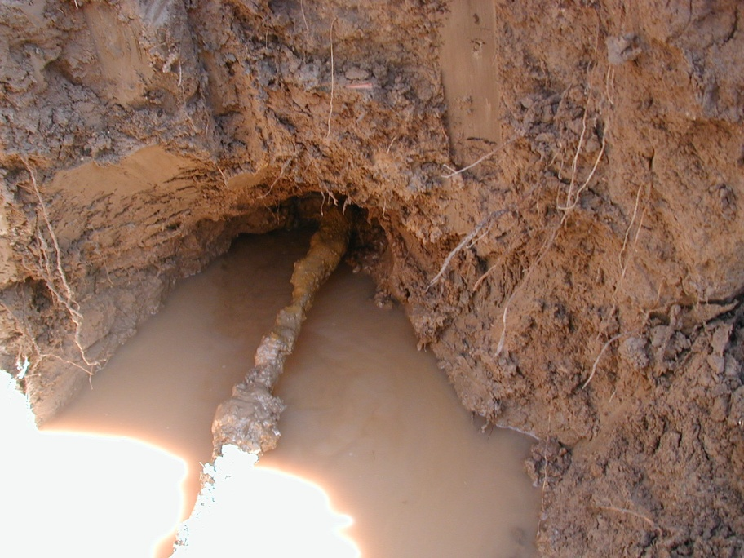
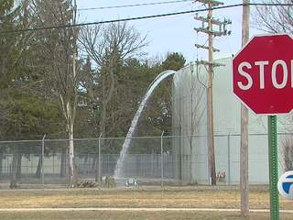
Component Analysis – Real Loss
68
LEAKAGE ON MAINS
LEAKAGE ON SERVICE LINES
LEAKAGE OR OVERFLOW AT STORAGE TANKS

Slide 69
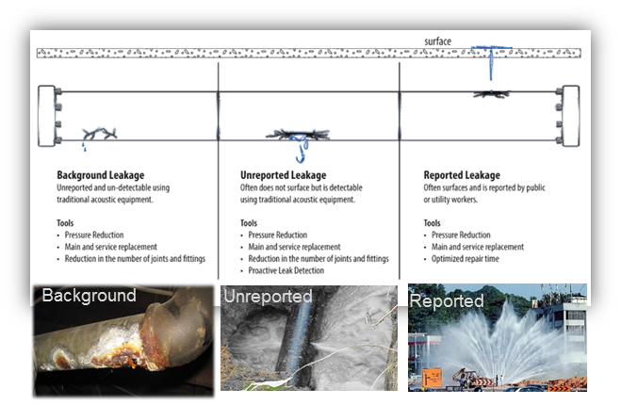
Real Loss Component Analysis
69
From a formula. Need to provide the ICF.
From your repair records.

Slide 70
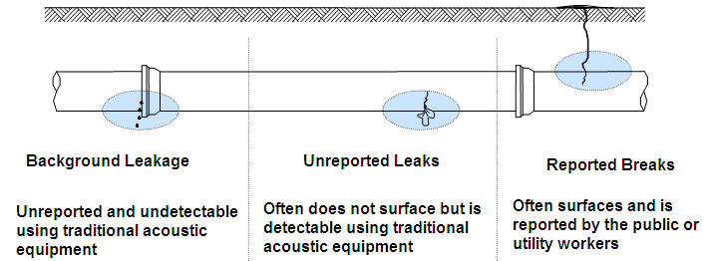
Component Analysis- Real Loss
70
Categories of Water Loss
Unavoidable
Detectable
Observable

Slide 71
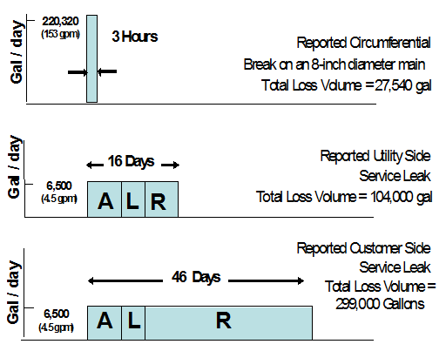
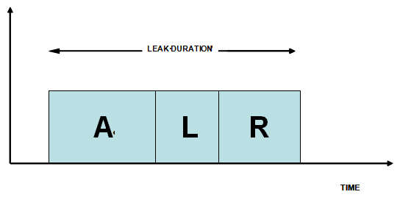
Real Loss Component Analysis: The Life of a Leak; Awareness, Location & Repair
71

Slide 72
Real Loss Component Analysis: Basic data needed
72
Failure Data
  Break type: reported/unreported
  Main or service
  Location
  Line size
  Day/time break discovered
  Day/time break was repaired
Other Data
  Storage tank volume (total)
  Average age of pipe network
  Data from AWWA M36 water audit

Slide 73
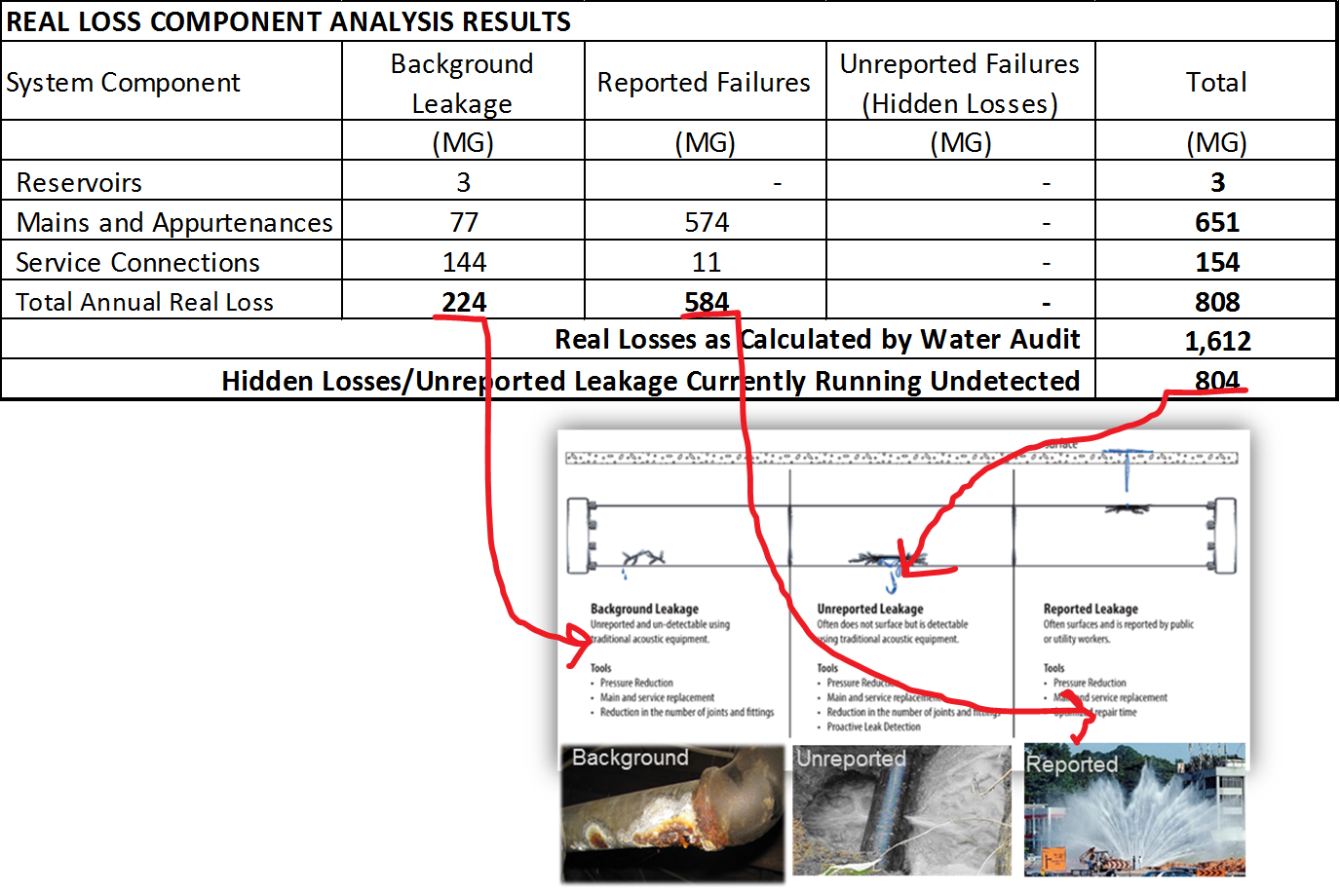
Real Loss Component Analysis Results
73

Slide 74
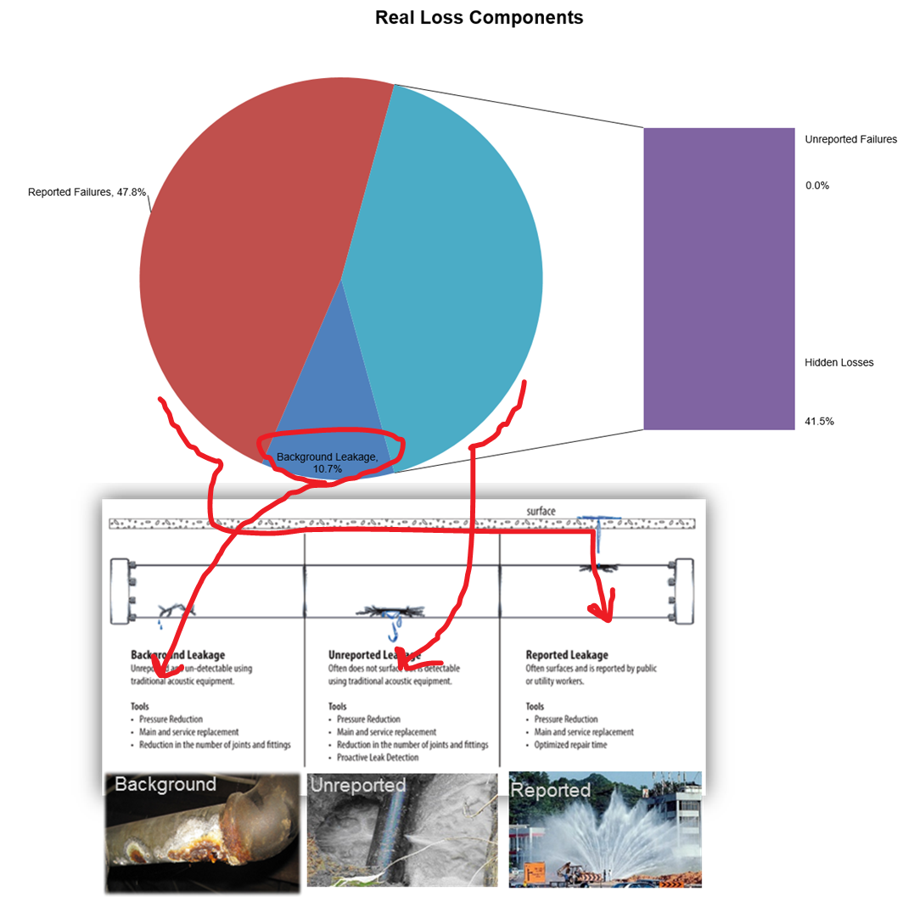
Real Loss Component Analysis Results
74

Slide 75
Component Analysis – Real Loss
75
What is my quantity of Unavoidable or Background Leakage (UARL)?
  Calculate based on:

Slide 76
Component Analysis – Real Loss
76
Pressure is a Big Factor
PRESSURE
PRESSURE
LOSSES
LOSSES

Slide 77
Component Analysis – Real Loss
77
Tools to address Background leakage:
  Pressure stabilization
  Pressure reduction
  Main and service line replacement
  Reduction of # of joints and fittings

Slide 78
Component Analysis – Real Loss
78
Reported Leaks
  Condition, type, & length of pipe
  Depth
  Type of soil
  Installation
  Pressure
  Inspection of system

Slide 79
Component Analysis – Real Loss
79
Tools to Address Reported Breaks
  Pressure stabilization
  Pressure reduction
  Main and service replacement
  Optimize repair and response time

Slide 80
Real Loss Component Analysis – Activity 3
80
Placeholder for Hands-On Activity #3
  Use AWWARf Leakage Component Analysis Model to update initial audit from Rockville WSC
  Identify volume & value of the real loss sub-component of the Rockville WSC NRW
Applied Activity #3
  Assemble and input your system’s break data into the AWWARf model
  Otherwise, develop a plan to collect, assemble and use the required break data for your audit

Slide 81
Component Analysis – Apparent Losses
81
Create a water balance: separate Non-Revenue Water into Unbilled Consumption, Apparent Loss and Real Loss.
Test the validity: Data Validity Score & Metrics screening, data validity checking
Analyze the components of Unbilled Consumption, Apparent Loss and Real Loss. Use volumes & values.
Prioritize the components to make a plan of attack.

Slide 82
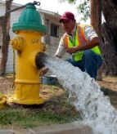




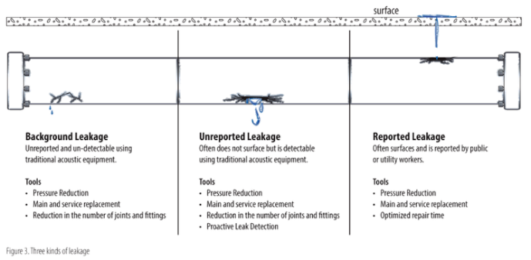
Component Analysis – Apparent Losses
82

Slide 83
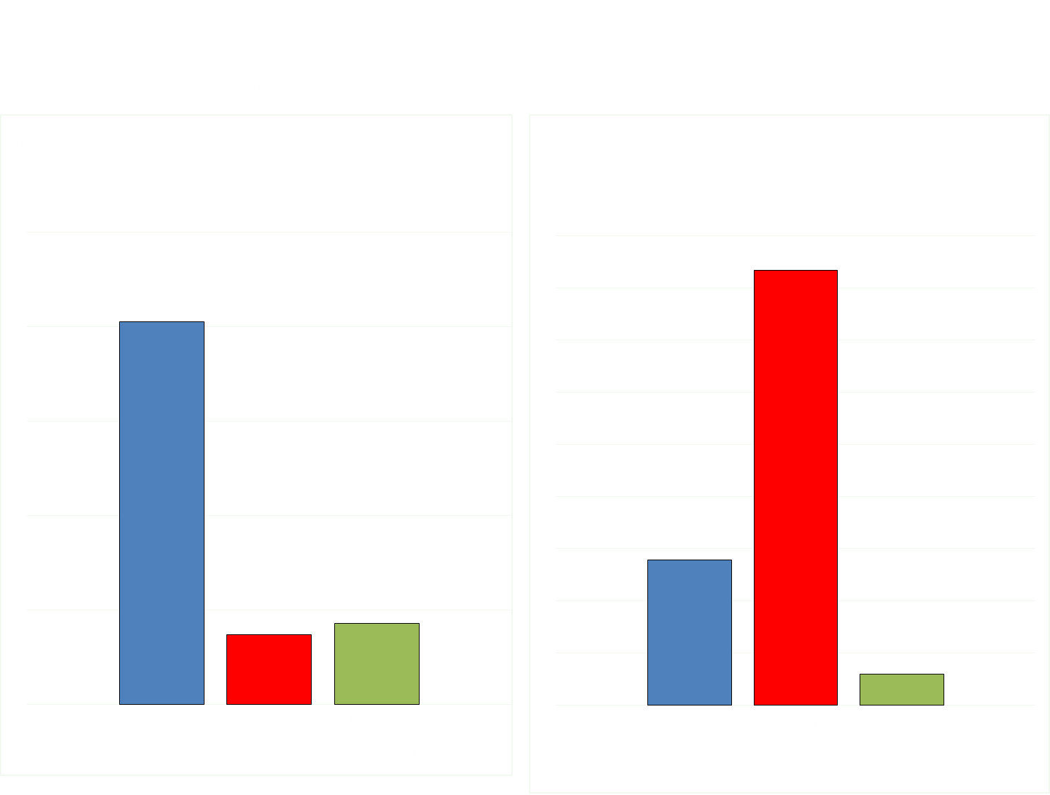

Slide 84
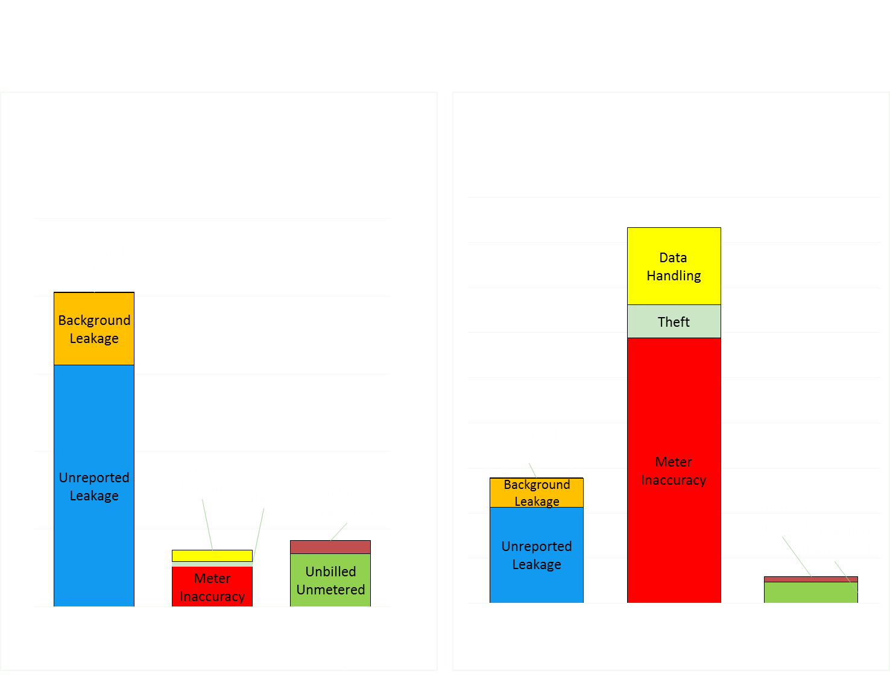

Slide 85
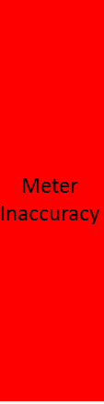
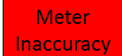
Volume
Value

Slide 86
Volume
Value
Level 4
Level 4
Small Meter Inaccuracy
Large Meter Inaccuracy
Meter Mis-Application

Slide 87
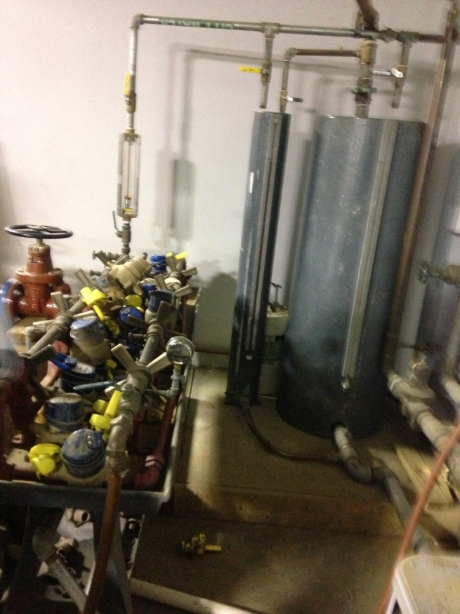
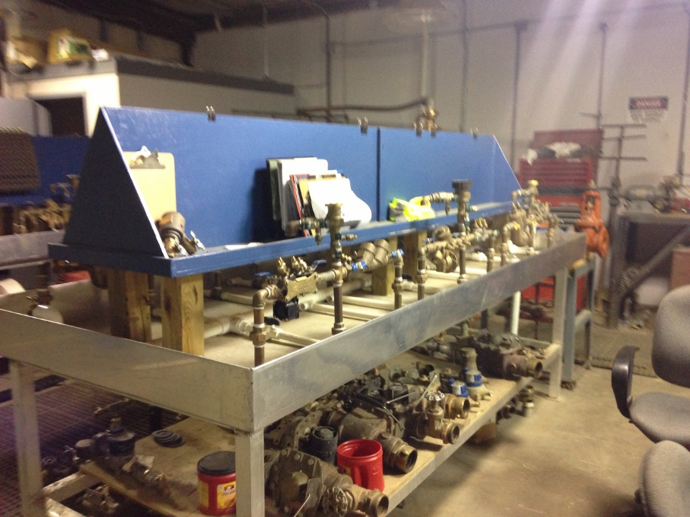

Component Analysis – Apparent Loss
87
Sample Testing for Small Meters

Slide 88
Component Analysis – Apparent Loss
88
Sample Testing for Small Meters
  Select sample to test
    Statistical significance (confidence, margin of error)
    Consider resources for testing
    Sample each type of meter with designed flow rate boundaries
  Described in AWWA M6 Manual

Slide 89
Component Analysis – Apparent Loss
Number of Meters in System
Revenue from Each Class of Meters
Notes:
89

Slide 90
Component Analysis – Apparent Loss
90
Targeted testing for Large Meters
  Annual revenue from large meters = $100,000
  Estimated inaccuracy = 5 %
  Annual large meter revenue loss = $5,000

Slide 91
Component Analysis – Apparent Loss
91
Picking which large meters to test
  Annual revenue from specific large meter = $10,000
  Estimated inaccuracy = 10%
  Annual large meter revenue being lost = $1,000
  Cost to test/repair meter = $ 500
  Is it worth it to test/repair this meter?

Slide 92
Component Analysis – Apparent Loss
92
Picking which meters to test
  Annual revenue from specific meter = $6,000
  Estimated inaccuracy = 5%
  Annual large meter revenue loss = $300
  Cost to test/repair meter = $ 500
  Is it working it to test/repair this meter?

Slide 93
Component Analysis – Apparent Loss
93
Picking which meters to test
  Annual revenue from specific meter = $25,000
  Estimated inaccuracy = 2%
  Annual large meter revenue loss = $500
  Cost to test/repair meter = $500
  Is it worth it to test/repair this meter?

Slide 94
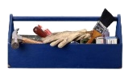
Toolbox
94
The Toolbox (Basic) | Helps to Address | Level of Cost
1 - Validation of supply & consumption volumes | Low Data Validity Score, Gremlins | Low-Mid
2 - Estimating and tracking unmetered use | Validity, Unmetered Use | None-Low
3 - Installing meters on unmetered connections | Unmetered Use | Mid
4 - Billing system audit | Systematic Data Handling Errors | Low-Mid
5 - Meter testing & replacement | Customer metering inaccuracy | Mid-High
6 - Unidirectional flushing program | Unbilled unmetered | Low
7 - Acoustic leak survey | Unreported leakage | Mid
8 - Improve speed/quality of repairs | Unreported, Reported leakage | Low
9 - Locate & eliminate pressure transients (surges, hammers) | All 3 types of leakage | Low-Mid
10 - Reduce peak and overall pressure | All 3 types of leakage | Mid-High

Slide 95
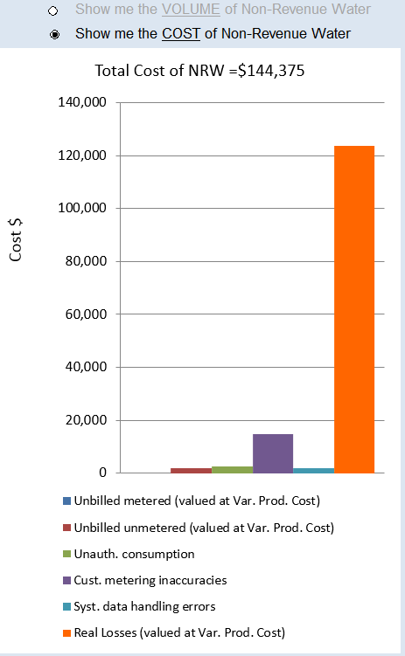

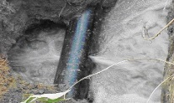
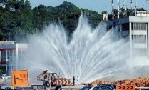
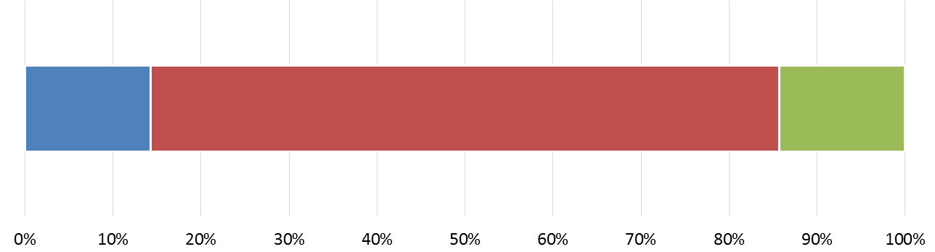
Toolbox
95
Background
Unreported
Reported

Slide 96
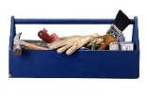
Toolbox
96
The Toolbox (Basic) | Helps to Address | Level of Cost
1 - Validation of supply & consumption volumes | Low Data Validity Score, Gremlins | Low-Mid
2 - Estimating and tracking unmetered use | Validity, Unmetered Use
3 - Installing meters on unmetered connections | Unmetered Use | Mid
4 - Billing system audit | Systematic Data Handling Errors | Low-Mid
5 - Meter testing & replacement | Customer metering inaccuracy | Mid-High
6 - Unidirectional flushing program | Unbilled unmetered | Low
7 - Acoustic leak survey | Unreported leakage | Mid
8 - Improve speed/quality of repairs | Unreported, Reported leakage | Low
9 - Locate & eliminate pressure transients (surges, hammers) | All 3 types of leakage | Low-Mid
10 - Reduce peak and overall pressure | All 3 types of leakage | Mid-High

Slide 97





Toolbox
97
Background
Unreported
Reported

Slide 98

Toolbox
98
The Toolbox (Basic) | Helps to Address | Level of Cost
1 - Validation of supply & consumption volumes | Low Data Validity Score, Gremlins | Low-Mid
2 - Estimating and tracking unmetered use | Validity, Unmetered Use
3 - Installing meters on unmetered connections | Unmetered Use | Mid
4 - Billing system audit | Systematic Data Handling Errors | Low-Mid
5 - Meter testing & replacement | Customer metering inaccuracy | Mid-High
6 - Unidirectional flushing program | Unbilled unmetered | Low
7 - Acoustic leak survey | Unreported leakage | Mid
8 - Improve speed/quality of repairs | Unreported, Reported leakage | Low
9 - Locate & eliminate pressure transients (surges, hammers) | All 3 types of leakage | Low-Mid
10 - Reduce peak and overall pressure | All 3 types of leakage | Mid-High

Slide 99





Toolbox
99
Background
Unreported
Reported

Slide 100

Toolbox
100
The Toolbox (Basic) | Helps to Address | Level of Cost
1 - Validation of supply & consumption volumes | Low Data Validity Score, Gremlins | Low-Mid
2 - Estimating and tracking unmetered use | Validity, Unmetered Use
3 - Installing meters on unmetered connections | Unmetered Use | Mid
4 - Billing system audit | Systematic Data Handling Errors | Low-Mid
5 - Meter testing & replacement | Customer metering inaccuracy | Mid-High
6 - Unidirectional flushing program | Unbilled unmetered | Low
7 - Acoustic leak survey | Unreported leakage | Mid
8 - Improve speed/quality of repairs | Unreported, Reported leakage | Low
9 - Locate & eliminate pressure transients (surges, hammers) | All 3 types of leakage | Low-Mid
10 - Reduce peak and overall pressure | All 3 types of leakage | Mid-High

Slide 101
Toolbox – Data Validity
101
If Data Validity Score is less than 50, focus on improving data validity
  Validation of supply & consumption volumes
  Estimating and tracking unmetered use
  Master Meter annual testing program
  Mapping the water system

Slide 102
Toolbox – Authorized, Unbilled usage
102
If Data Validity Score is greater than 50, and If areas of focus include Authorized, Unbilled consumption:
  Review policies & procedures for unbilled customers
  Install meters on unmetered connections
  Unidirectional Flushing Program
  Customer meter testing & replacement program
  Theft deterrence
  Billing system audit

Slide 103
Toolbox: Real Losses
103
If Data Validity Score is greater than 50, and if areas of focus include real losses:
  Collecting & Analysis of break data
  Improve speed/quality of repairs
  Locate & eliminate pressure transients (surges, hammers, etc.)
  Night flow analysis
  Reduce peak & overall pressure
  Main replacement
  Acoustic Leak Survey

Slide 104

Real Loss Component Analysis Results
104

Slide 105

Real Loss Component Analysis Results
105

Slide 106

Real Loss Component Analysis Results
106

Slide 107

Real Loss Component Analysis Results
107

Slide 108

Real Loss Component Analysis Results
108

Slide 109
Summary and Toolbox Decisions – Activity 4
109
Placeholder for Hands-On Activity #4
  ID all appropriate toolbox tools to address NRW for each system in A#4 Toolbox Decision Exercise
  Fine-tune Rockville WSC audit for individual data validity, overall data score, performance indicators and total annual cost of NRW
    ID all appropriate toolbox tools to address Rockville WSC NRW
Applied Activity #4
  Summarize your own system’s audit
  ID all appropriate toolbox tools to address your NRW

Slide 110
What we learned
110
What is a Water Audit?
What are the Benefits to annual water audits?
What triggers voluntary & required water audits?
How to conduct a water audit using AWWA M36 software
How to interpret and report data validity
How to interpret audit results – Volumes and Values
How to interpret results from AWWA M36 software
How to use results to implement corrective actions

Slide 111
Hands-On Activity #1
111
Go to www.awwa.org to download a copy of the free water audit software to your computer
Open the software (enable editing, content, macros) to ensure it works – you need Excel
Use the Rockville Water Supply Corp Background Info to enter data into the software
  Use A#1 Software Exercise Results Excel file to check your entries for all software tabs
Use this water balance exercise to identify your own system data needed to populate audit inputs

Slide 112
Hands-On Activity #2
112
Use the A#2 Data Validity Exercise to fine-tune the water balance inputs for the Rockville WSC
  Use the A#2 Data Validity Exercise Trainer Notes for the water balance breakdown
Input water balance data without, and then with data grades
  Download each audit separately to see how it displays validity data without and with data grades
  Compare your results with the A#2 Exercise Results without and with data grades

Slide 113
Applied Activity #2
113
Follow the instructions presented in the A#2 Data Validity Applied Activity to assign data validity scores for each water balance component of your water system
This will identify those components of your water balance that need more attention in order to bring your overall data validity score > 50

Slide 114
Hands-On Activity #3
114
Download a copy of the free AWWARf Leakage Component Analysis Model from http://www.waterrf.org/resources/pages/PublicWebTools-detail.aspx?ItemID=27 to your computer
Open the software (enable editing, content, macros) to ensure it works – you need Excel
Expand the Rockville water balance by following instructions and using data from the A#3a Real Loss and #3b Leakage Component Analysis exercises
  This will ID the real loss sub-component of NRW

Slide 115
Applied Activity #3
115
Follow the instructions presented in the A#3 Real Loss and Leakage Component Applied Activity to assemble main and service line break and leakage data
If you already have this data for your water system enter it into the AWWARf Leakage Component Analysis Model
  Otherwise, develop a plan for your system to collect and maintain records of this data
This will allow you to use the software to calculate the real loss sub-components of your NRW

Slide 116
Hands-On Activity #4
116
Use the A#4 Toolbox Decision Exercise to evaluate each of the systems audit results for overall validity score, performance indicators and total annual cost of NRW
On each systems evaluation form record your observations of the metrics, the top three focus areas and from the ten toolbox tools the best tool(s) to address each focus area
Check your conclusions using the A#4 Toolbox Decision Exercise Trainer Notes

Slide 117
Applied Activity #4
117
Follow the instructions presented in the A#4 Summary and Toolbox Decision Applied Activity to work through an entire audit for your system
You may already have previous steps of the audit completed; use this activity to review the data you used for those steps
Develop a plan to continue to improve system data for the audit and create a schedule to conduct the audit annually

Slide 118
Questions?
118
Thank you

